Slide 1
AUTOMATE DEPLOYMENT USING VM

Slide 2
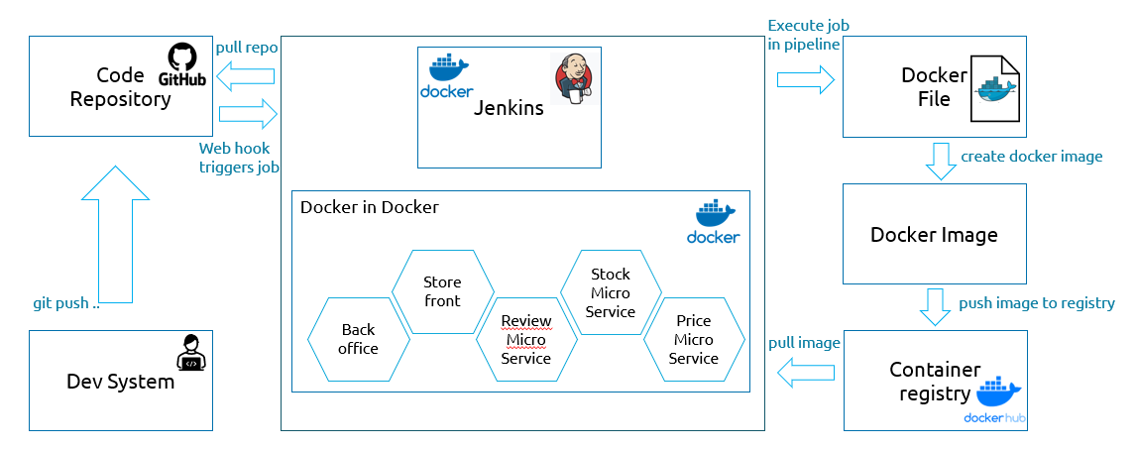
CI/CD Automation using Github, Jenkins and Docker

Slide 3
Setup AWS Linux Debian 11 VM with 16 GB memory and hard disk 256 GB
Installed docker
Installed Jenkins as docker container
Pipeline created in it and in Jenkinsfile satges are defined
For automate build we created webhook in git repo setting with push event
Installed SonarQube as docker container
For GitHub integration with SonarQube , created githubApp in git setting and installed it
Now , in SonarQube selected the project for which Jenkin integration need to be done
For that created sonar-project.properties file created and added sonar.ProjectKey value in it
In Jenkinsfile added SonarQube Analysis stage for doing the analysis on SonarQube
WORKFLOW:

